Slide 1


Slide 2
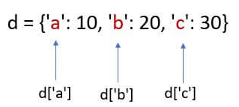
Definition
Dictionaries
Used to store data values in key:value pairs
They are mutable sequences of elements in Python
Unordered : Without any index number
Keys are always unique

Slide 3

Usage
Dictionaries
Provides efficient data retrieval based on keys
Used for organizing and accessing data by unique keys rather than indexes
Ideal for creating mappings and storing related information

Slide 4

Advantage
Dictionaries
Fast access to data using keys
Allows for flexible and dynamic data organization

Slide 5

Format
Dictionaries
Dictionaries are defined using curly brackets. i.e. { and }
key-value pairs separated by colons
Items separated by commas

Slide 6
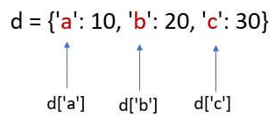
Dictionaries
Add data
# Add a new key-value pair
d[‘name'] = ‘hp’
Create empty Dictionary
d = { }
Remove data
Populate Dictionary
# Delete key-value pair by key without returning value
del d['c'] # Deletes key 'c'
d = {‘a’:10, ‘b’:20, ‘c’:30}
# Remove key-value pair by key and return value
value = d.pop('b') # Removes key 'b' and returns its value
Update data
# Remove and return the last key-value pair
key, value = d.popitem()
# Update the value for an existing key d['a'] = 11

Slide 7

Create 1 dictionary of your own choice and demonstrate operations

Slide 8

Definition
Sets
Unordered collections of unique elements in Python
Do not allow duplicate values
New items can be added even after creating set
Immutable : Once created, their elements cannot be changed

Slide 9
Usage
Sets
Used for removing duplicates from data
Performing set operations (union, intersection, difference)

Slide 10
Advantage
Setss
Ensures uniqueness of elements
Provides efficient set operations
Useful for mathematical operations on collections

Slide 11

Format
Sets
Sets are defined using curly brackets. i.e. { and }
Elements separated by commas

Slide 12

Add data
Sets
# Add a single element to the set
S.add(6)
# Add multiple elements to the set
S.update([7, 8])
Create empty Set
S = set()
Remove data
Populate Dictionary
# Remove a specific element
S.remove(3) # Removes element 20
S = {20, ’Jessa’, 35.75}
# Remove a specific element without error if not present S.discard(10) # Does nothing since 10 is not in the set
Update data
# Update an element in the set
S.discard(2) # Remove the old element (if exists)
S.add(20) # Add the new element
# Remove and return an arbitrary element
element = S.pop()
# Removes and returns an arbitrary element

Slide 13
Create 1 set of your own choice and demonstrate operations

Slide 14
HOME
Think of an app of your choice and determine where the use of followings is required :
-> Dictionary
-> Set
Create 1 each as per scenario

